Slide 1
Discussion 10 First Order Logic
Original Credit to: Jinghao Zhao
Modified by: Sidi Lu, 12/03/2021

Slide 2
Outline
Syntax: how to write sentences
What kind of sentences are well-formed?
Semantics: how to interpret sentences
Is this sentence True given this possible world(model)?
Inference
How to determine entailment?

Slide 3
Syntax
The same as in Propositional Logic, we have sentences in FOL.
A sentence is evaluated as True/False with respect to a model.
Here we discuss how a sentence is formed in FOL.
We first see some sentence examples and move to the basic elements.

Slide 4
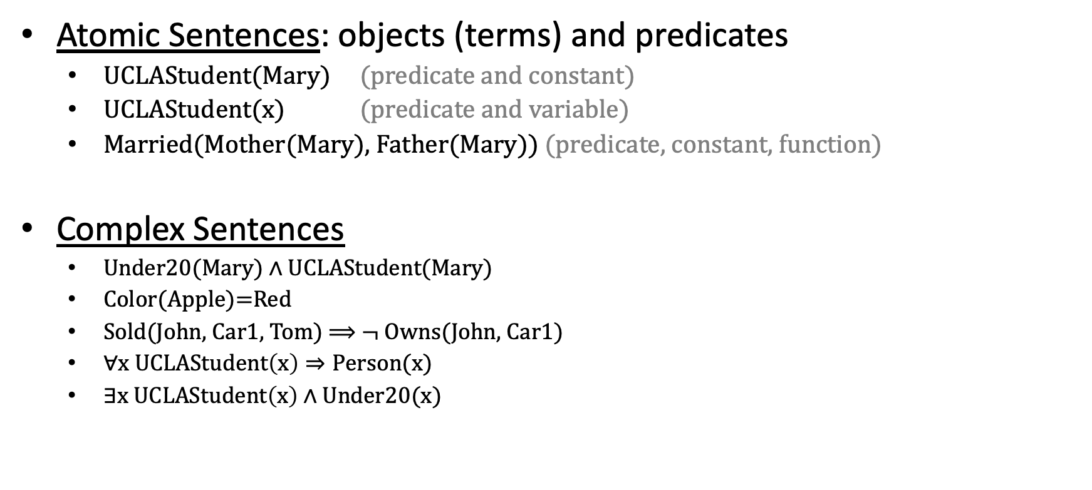
Sentences Types and Examples
Atomic Sentences: objects (terms) and predicates
UCLAStudent(Mary) (predicate and constant)
UCLAStudent(x) (predicate and variable)
Married(Mother(Mary), Father(Mary)) (predicate, constant, function)
Complex Sentences
Under20(Mary) $∧$ UCLAStudent(Mary)
Color(Apple)=Red
Sold(John, Car1, Tom) $⟹$ $¬$Owns(John, Car1)
$∀x UCLAStudent\left(x\right)⇒Person(x)$
$∃x UCLAStudent\left(x\right)∧Under20(x)$

Slide 5
Basic Elements
Objects (a.k.a. Terms)
Constants
e.g., Apple, Pear, Mary, UCLA
Variables
e.g., x, y, z
Complex terms (having functions)
e.g., Mother(Mary), Color(Apple), Color(x)
A ground term is a term without variables
e.g., Apple, Color(Apple)
By convention, variables are represented by lowercase letters.
Functions (Return another constant)

Slide 6
Basic Elements
Predicates (Evaluated as True/False)
Properties (unary)
UCLA_student(Mary)
relations (n-ary)
Loves(Richard, Dog_of_Richard)
Brother(Richard, John)

Slide 7
Atomic Sentences
Objects (Terms)
Atomic Sentences
Predicates
Atomic Sentences Consist of terms (objects) and predicates
Examples
UCLAStudent(Mary)
UCLAStudent(x)
Married(Mother(Mary), Father(Mary))
The following is NOT a sentence:
Mary, x, Mother(Mary)
(They are not True or False!)

Slide 8
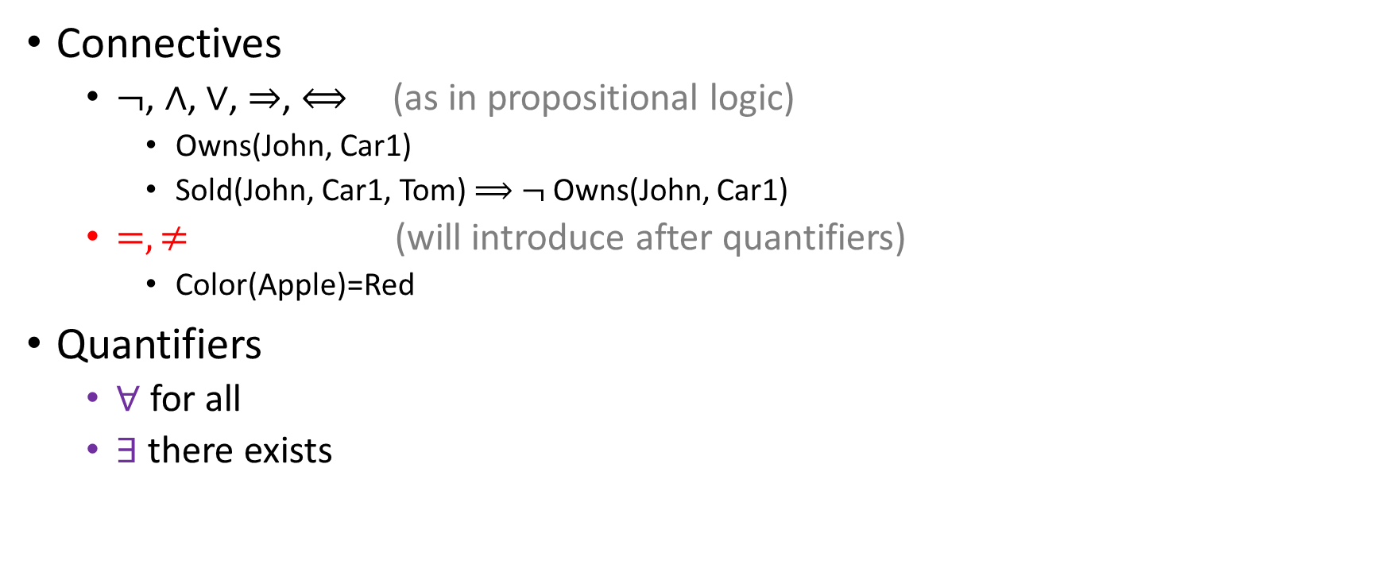
From Atomic Sentences to Complex Sentences
Connectives
$¬$, $∧$, $∨$, $⇒$, $⟺$ (as in propositional logic)
Owns(John, Car1)
Sold(John, Car1, Tom) $⟹$ $¬$Owns(John, Car1)
$=, ≠$ (will introduce after quantifiers)
Color(Apple)=Red
Quantifiers
$∀$ for all
$∃$ there exists

Slide 9
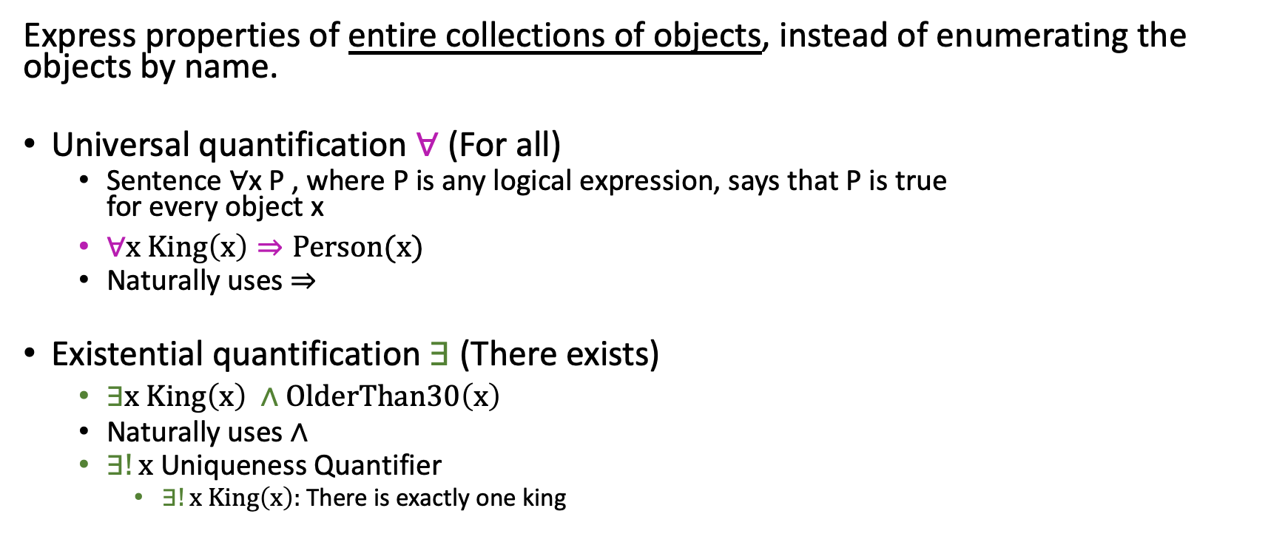
Quantifiers
Express properties of entire collections of objects, instead of enumerating the objects by name.
Universal quantification $∀$ (For all)
Sentence ∀x P , where P is any logical expression, says that P is true for every object x
$∀x King\left(x\right)⇒Person(x)$
Naturally uses $⇒$
Existential quantification ∃ (There exists)
$∃x King\left(x\right) ∧OlderThan30\left(x\right)$
Naturally uses $∧$
$∃!x$ Uniqueness Quantifier
$∃!x King\left(x\right):$There is exactly one king
Notes:
For all x, if x is a king, then x is a person
the sentence ∀ x P , where P is any logical expression, says that P is true for every object x
Naturally, universal quantification goes with implication and existential quantification goes with "and"

Slide 10
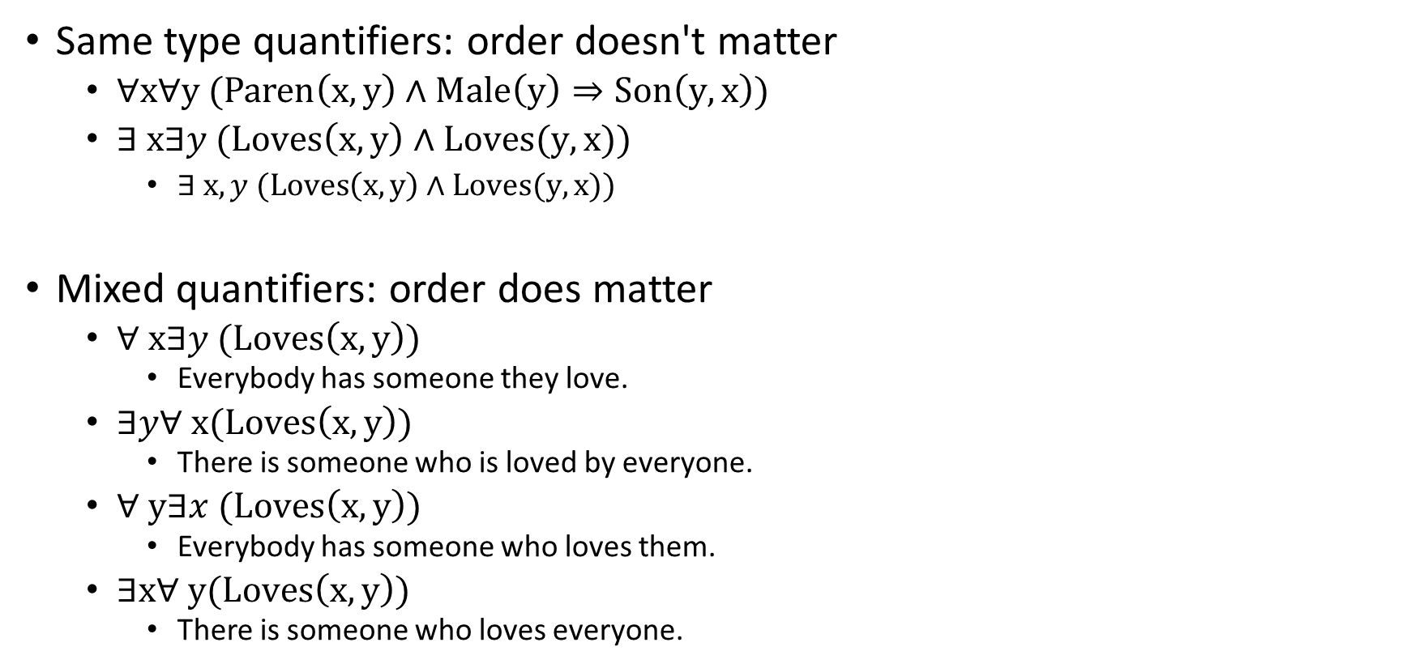
Quantifiers - Nesting Quantifiers
Same type quantifiers: order doesn't matter
$∀x∀y (Paren\left(x,y\right)∧Male\left(y\right)⇒Son\left(y,x\right))$
$∃ x∃y (Loves\left(x,y\right)∧Loves(y,x))$
$∃ x, y (Loves\left(x,y\right)∧Loves(y,x))$
Mixed quantifiers: order does matter
$∀ x∃y (Loves\left(x,y\right))$
Everybody has someone they love.
$∃y∀ x(Loves\left(x,y\right))$
There is someone who is loved by everyone.
$∀ y∃x (Loves\left(x,y\right))$
Everybody has someone who loves them.
$∃x∀ y(Loves\left(x,y\right))$
There is someone who loves everyone.
Notes:
(1) Everybody has someone they love.
(2) There is someone who is loved by everyone.
(3) Everybody has someone who loves them.
(4) There is someone who loves everyone.

Slide 11

Exercise
Are they equivalent? What do they mean?
$∀x King\left(x\right)⇒Person(x)$
$∀x King\left(x\right)∧Person(x)$
$∃x King\left(x\right) ∧OlderThan30\left(x\right)$
$∃x King\left(x\right)⇒OlderThan30\left(x\right)$
Notes:
$$∀x King\left(x\right)∧Person(x)$$
Everything in the domain is both a king and a person. (too strong)
$$∃x King\left(x\right)⇒OlderThan30\left(x\right)$$
If there is one person that's not a king, this is true. If there is anything that's older than 30, this is true. (too weak)

Slide 12
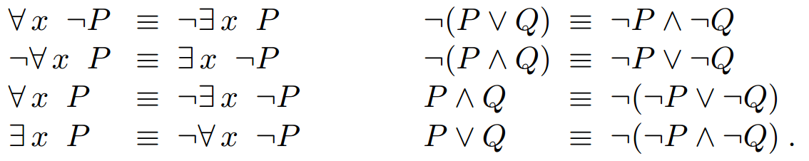

Logical Equivalence for Quantifiers
$∀$ and $∃$
$$∀x King\left(x\right)⇒Person(x)$$
$¬∃x ¬$ $(King\left(x\right)⇒Person\left(x\right))$

Slide 13
Exercise
Are they equivalent? What do they mean?
$∀x King\left(x\right)⇒Person(x)$
$∀x King\left(x\right)∧Person(x)$
$∃x King\left(x\right) ∧OlderThan30\left(x\right)$
$∃x King\left(x\right)⇒OlderThan30\left(x\right)$
Model:
Three persons:
Richard (King, 50 years old)
John (Richard's brother, 20 years old)
Elizabeth (Richard's mother)
A dog:
Gigi (Richard's dog)
Notes:
$$∀x King\left(x\right)∧Person(x)$$
Everything in the domain is both a king and a person. (too strong)
$$∃x King\left(x\right)⇒OlderThan30\left(x\right)$$
If there is one person that's not a king, this is true. If there is anything that's older than 30, this is true. (too weak)

Slide 14
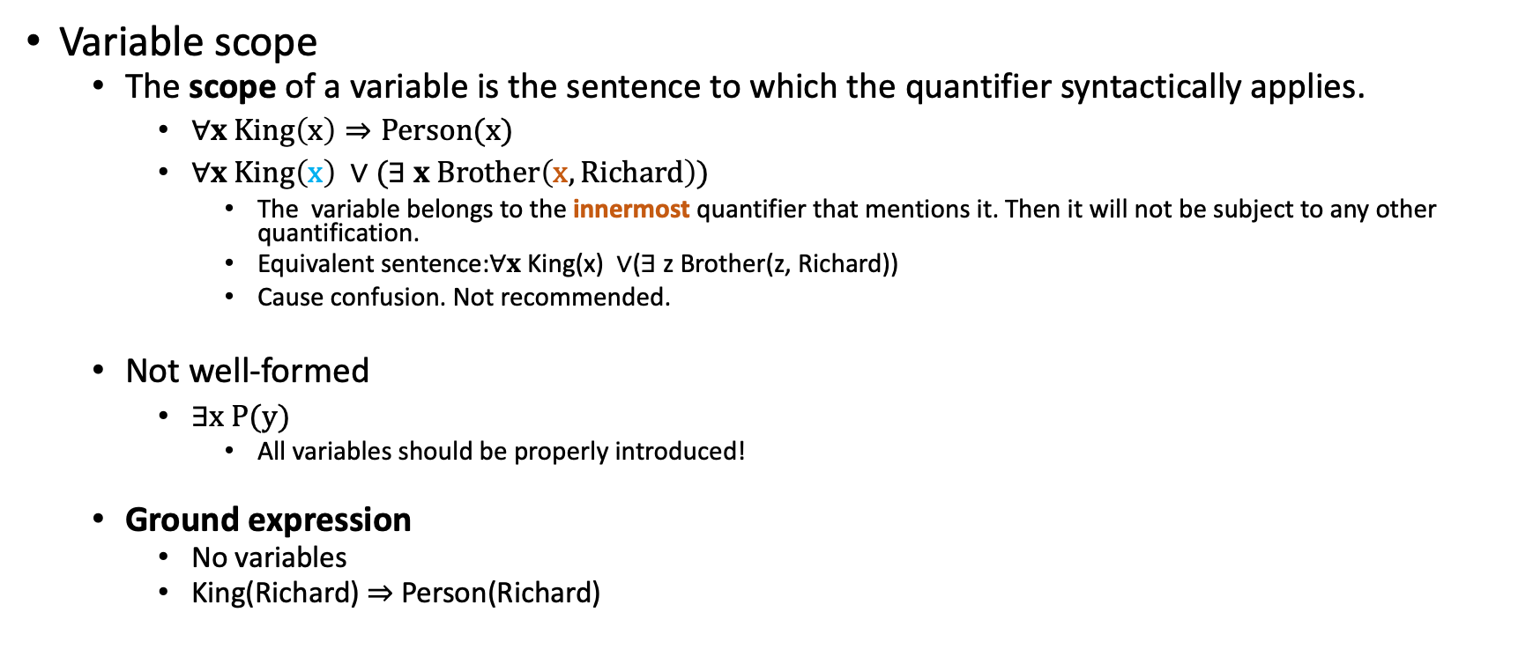
More about quantifiers
Variable scope
The scope of a variable is the sentence to which the quantifier syntactically applies.
$∀x King\left(x\right)⇒Person(x)$
$∀x King\left(x\right) ∨(∃ x Brother\left(x, Richard\right))$
The variable belongs to the innermost quantifier that mentions it. Then it will not be subject to any other quantification.
Equivalent sentence:∀𝐱 King(x) ∨(∃ z Brother(z, Richard))
Cause confusion. Not recommended.
Not well-formed
$∃x P(y)$
All variables should be properly introduced!
Ground expression
No variables
King(Richard) $⇒$ Person(Richard)

Slide 15

Logical Connective - Equality
Equality $=$ (identity relation)
$\text{Color}\text{(}\text{Apple}\text{)=}\text{Red}$ (True)
$\text{Color}\text{(}\text{Apple}\text{)=}\text{Blue}$ (False)

Slide 16
Exercise 1
Write FOL sentences:
Richard has (at least) two brothers

Slide 17
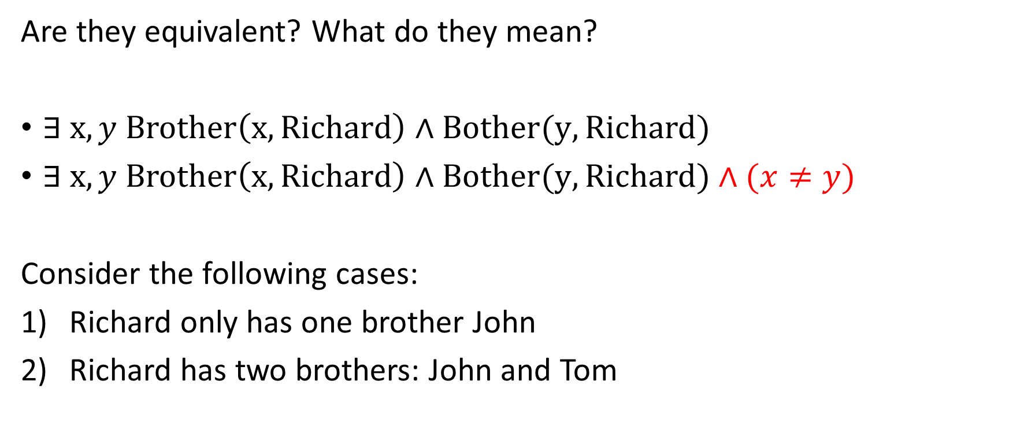
Hints for Exercise 1
Are they equivalent? What do they mean?
$∃ x, y Brother\left(x, Richard\right)∧Bother(y, Richard)$
$∃ x, y Brother\left(x, Richard\right)∧Bother(y, Richard)∧(x≠y)$
Consider the following cases:
Richard only has one brother John
Richard has two brothers: John and Tom

Slide 18

Exercise 1
Write FOL sentences:
Richard has (at least) two brothers
$∃ x, y Brother\left(x, Richard\right)∧Bother(y, Richard)∧(x≠y)$

Slide 19
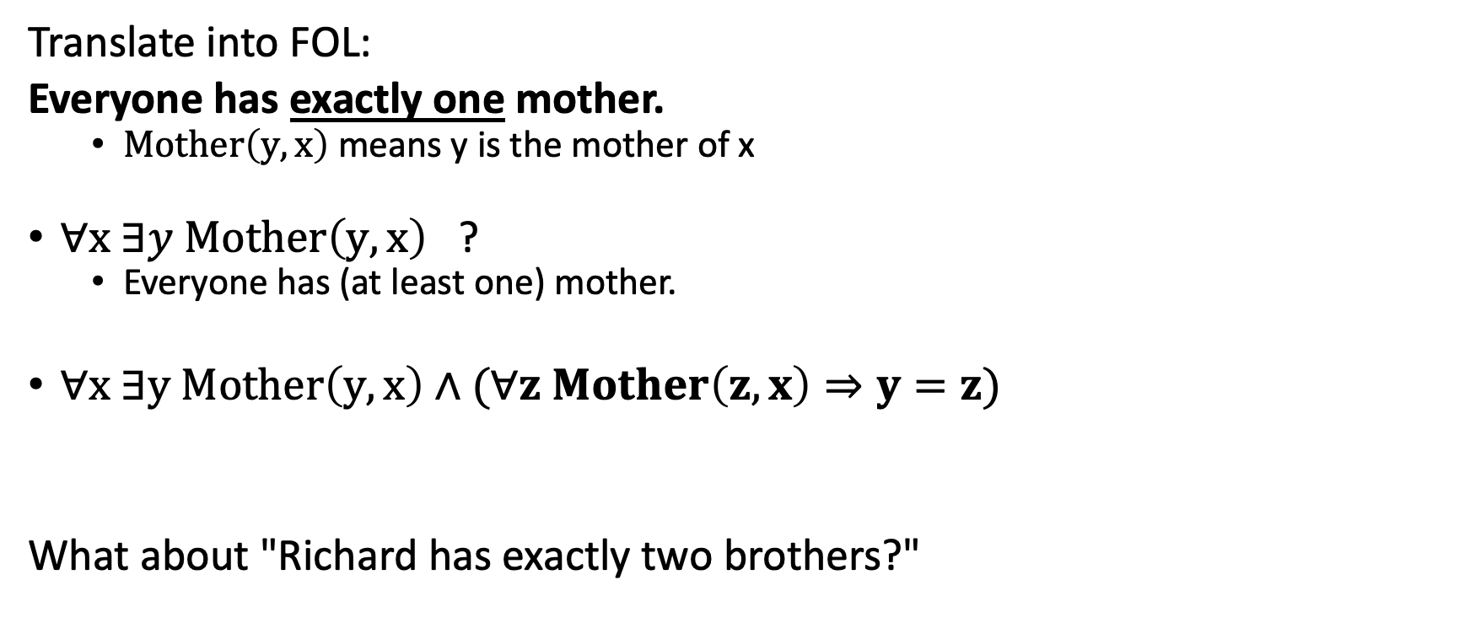
Exercise 2
Translate into FOL:
Everyone has exactly one mother.
$Mother\left(y, x\right)$ means y is the mother of x
$∀x ∃y Mother\left(y, x\right)$ ?
Everyone has (at least one) mother.
$∀x ∃y Mother\left(y, x\right)∧(∀z Mother\left(z, x\right)⇒y=z)$
What about "Richard has exactly two brothers?"

Slide 20
Exercise 3 – Translating English to FOL
Every gardener likes sunshine
You can fool some people all the time.
You can fool all the people some of the time.

Slide 21

Exercise 3 – Translating English to FOL
Every gardener likes sunshine
You can fool some people all the time.
$∃x∀t$
You can fool all the people some of the time.
$∀x∃t$

Slide 22
Outline
Syntax: how to write sentences
What kind of sentences are well-formed?
Semantics: how to interpret sentences
Is this sentence True given this possible world(model)?
Inference
How to determine entailment?

Slide 23

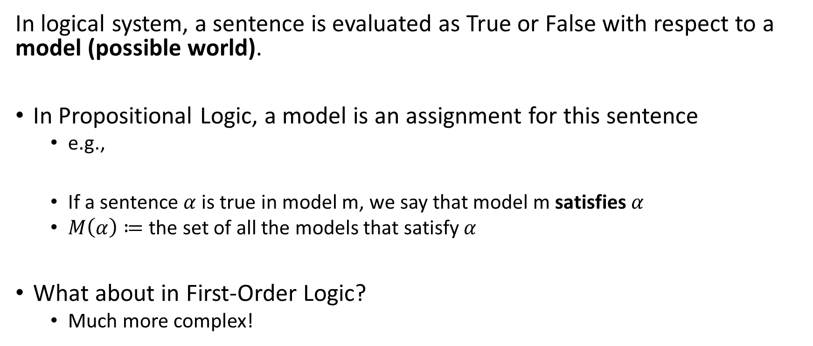
Models
In logical system, a sentence is evaluated as True or False with respect to a model (possible world).
In Propositional Logic, a model is an assignment for this sentence
e.g.,
If a sentence $α$ is true in model m, we say that model m satisfies $α$
$M\left(α\right)≔$the set of all the models that satisfy $α$
What about in First-Order Logic?
Much more complex!

Slide 24
Models in FOL
A model in FOL consists of:
A set of objects
A set of functions + what values will be returned
A set of predicates + what values will be returned

Slide 25
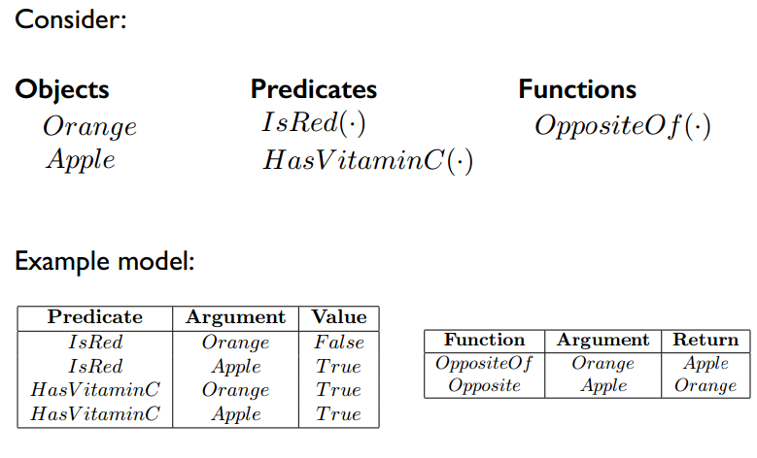
Example - Model
https://www2.cs.duke.edu/courses/spring15/compsci270/slides/270_6.pdf

Slide 26

Example – A Model
Sentence: $∀x King\left(x\right)⇒Person(x)$
Consider the following case:
Three persons:
Richard (King, 50 years old)
John (Richard's brother, 20 years old)
Elizabeth (Richard's mother)
A dog:
Gigi (Richard's dog)

Slide 27
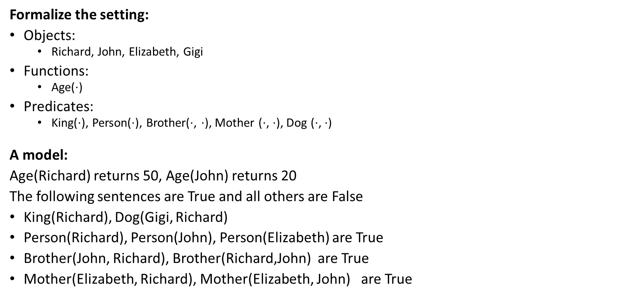
Example – A Model (Possible World)
Three persons:
Richard (King, 50 years old)
John (Richard's brother, 20 years old)
Elizabeth (Richard's mother)
A dog:
Gigi (Richard's dog)
Formalize the setting:
Objects:
Richard, John, Elizabeth, Gigi
Functions:
Age($⋅$)
Predicates:
King($⋅$), Person($⋅$), Brother($⋅$, $⋅$), Mother ($⋅$, $⋅$), Dog ($⋅$, $⋅$)
A model:
Age(Richard) returns 50, Age(John) returns 20
The following sentences are True and all others are False
King(Richard), Dog(Gigi, Richard)
Person(Richard), Person(John), Person(Elizabeth) are True
Brother(John, Richard), Brother(Richard,John) are True
Mother(Elizabeth, Richard), Mother(Elizabeth, John) are True

Slide 28

Example – A Model (Possible World)
Three persons:
Richard (King, 50 years old)
John (Richard's brother, 20 years old)
Elizabeth (Richard's mother)
A dog:
Gigi (Richard's dog)
Formalize the setting:
Objects:
Richard, John, Elizabeth, Gigi
Functions:
Age($⋅$)
Predicates:
King($⋅$), Person($⋅$), Brother($⋅$, $⋅$), Mother ($⋅$, $⋅$), Dog ($⋅$, $⋅$)

Slide 29
Example – A Model (Possible World)
A model should define the values for functions and predicates for all possible inputs.
Here we simplify the presentation of our model as follows.
Age(Richard) returns 50, Age(John) returns 20
The following sentences are True and all others are False
King(Richard), Dog(Gigi, Richard)
Person(Richard), Person(John), Person(Elizabeth) are True
Brother(John, Richard), Brother(Richard,John) are True
Mother(Elizabeth, Richard), Mother(Elizabeth, John) are True

Slide 30
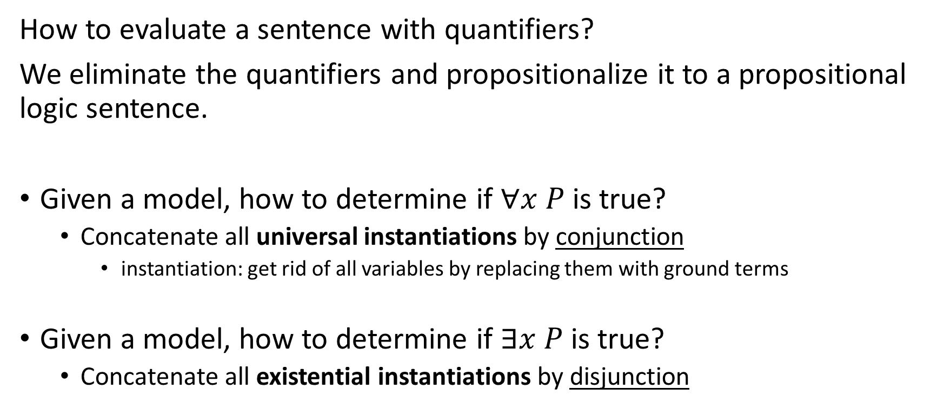
Propositionalization
How to evaluate a sentence with quantifiers?
We eliminate the quantifiers and propositionalize it to a propositional logic sentence.
Given a model, how to determine if $∀x P$ is true?
Concatenate all universal instantiations by conjunction
instantiation: get rid of all variables by replacing them with ground terms
Given a model, how to determine if $∃x P$ is true?
Concatenate all existential instantiations by disjunction

Slide 31

Example - Propositionalization
Determine if this is true:
$$∀x King\left(x\right)⇒Person(x)$$

Slide 32

Example - Propositionalization
Determine if this is true:
$$∀x King\left(x\right)⇒Person(x)$$
1. Extend the interpretation:
$x→$Richard
$x→$ John
$x→$ Elizabeth
$x→$ Gigi

Slide 33
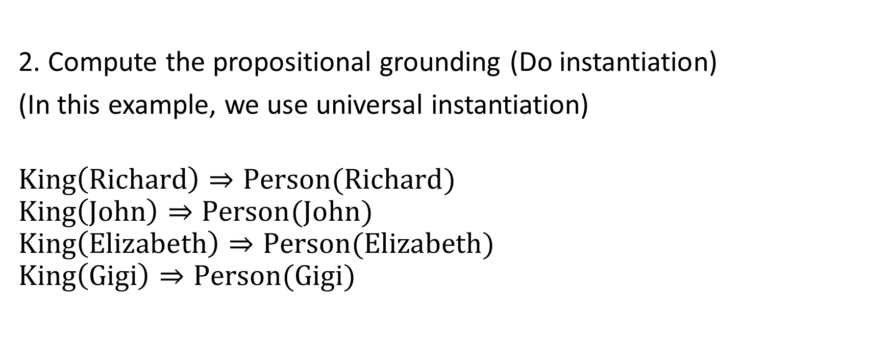
Example - Propositionalization
2. Compute the propositional grounding (Do instantiation)
(In this example, we use universal instantiation)
$$King\left(Richard\right)⇒Person(Richard)$$
$$King\left(John\right)⇒Person(John)$$
$$King\left(Elizabeth\right)⇒Person(Elizabeth)$$
$$King\left(Gigi\right)⇒Person(Gigi)$$

Slide 34
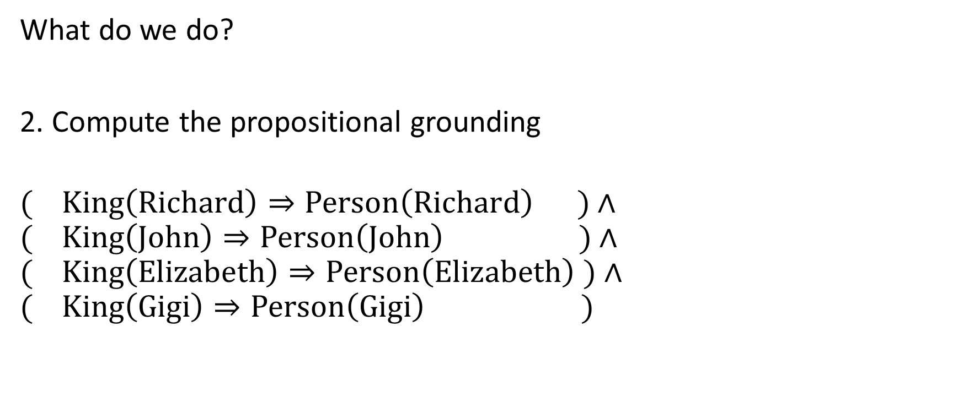
Example
What do we do?
2. Compute the propositional grounding
$$( King\left(Richard\right)⇒Person\left(Richard\right) )∧$$
$$( King\left(John\right)⇒Person\left(John\right) )∧$$
$$( King\left(Elizabeth\right)⇒Person\left(Elizabeth\right) )∧$$
$$( King\left(Gigi\right)⇒Person\left(Gigi\right) )$$

Slide 35
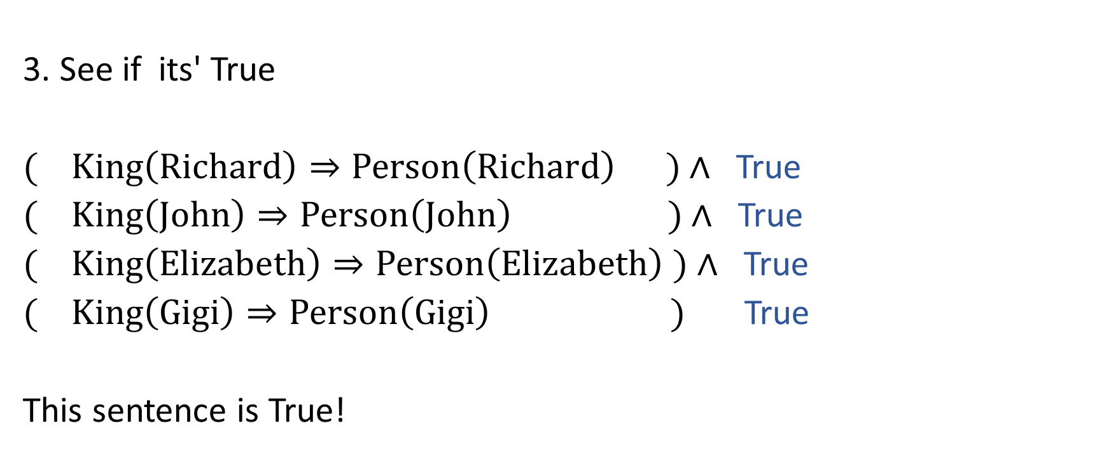
Example
3. See if its' True
$( King\left(Richard\right)⇒Person\left(Richard\right) )∧$ True
$( King\left(John\right)⇒Person\left(John\right) )∧$ True
$( King\left(Elizabeth\right)⇒Person\left(Elizabeth\right) )∧$ True
$( King\left(Gigi\right)⇒Person\left(Gigi\right) )$ True
This sentence is True!

